Slide 1
Testing Session-5

Slide 2
Agenda
Non Functional Testing
User Acceptance testing
Alpha Testing
Beta Testing

Slide 3
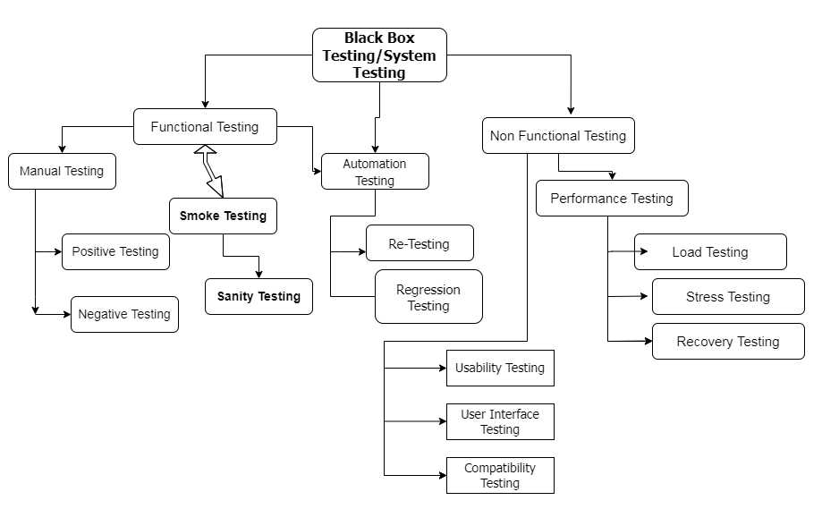

Slide 4
Performance testing
Net work delay
Client-Server processing
Data base transactions processing
Load balancing b/w Servers
Data rendering

Slide 5
Load testing
By Software accessing by large input data
By Virtual users count
Load runner, App Loader, IBM rational, Apache JMeter, Visual studio load test

Slide 6
Stress testing
Beyond the actual/max load limit
To identify the Break Point
Shut down or Restart
Turning the data base on or off

Slide 7
Recovery testing
System Crashes
Power Failure
Hard ware failures

Slide 8
Security Testing
Authentication Testing
Right information to the right user
Authorisation testing
Setting Privileges and
changing the privileges

Slide 9
Globalisation testing
Localisation (L10N) testing
10 languages for one iteration
Internationalisation(L18N) Testing
18 languages for one iteration

Slide 10
Grey Box Testing
Ad-Hoc Testing
Exploratory Testing

Slide 11
User Acceptance testing
Alpha testing
Test Environment(Testers)
Beta Testing
Client Environment(Client’s team)

Slide 12
Why Swhizz?
Following the project-oriented training By working on user stories
Real time people will deliver the classes
Hands on experience.
One to One monitoring
Interaction sessions
Doubts Clarification Session
Expertise in resume preparation
Mock interviews
Job assistance
Associated with 50+ Clients
900+ students got placed

Slide 13

Any Queries?

Slide 14
Thank You
Mr.SubbaRao (Relationship Manager)
Contact:9059002244

